Slide 1

Welcome to the
Lunch and Learn

Slide 2

More Than A Meal:
Findings and Implications Going Forward
Presenter: Linda Netterville, RD, LD
Vice President, Grants Management
Meals on Wheels America

Slide 3
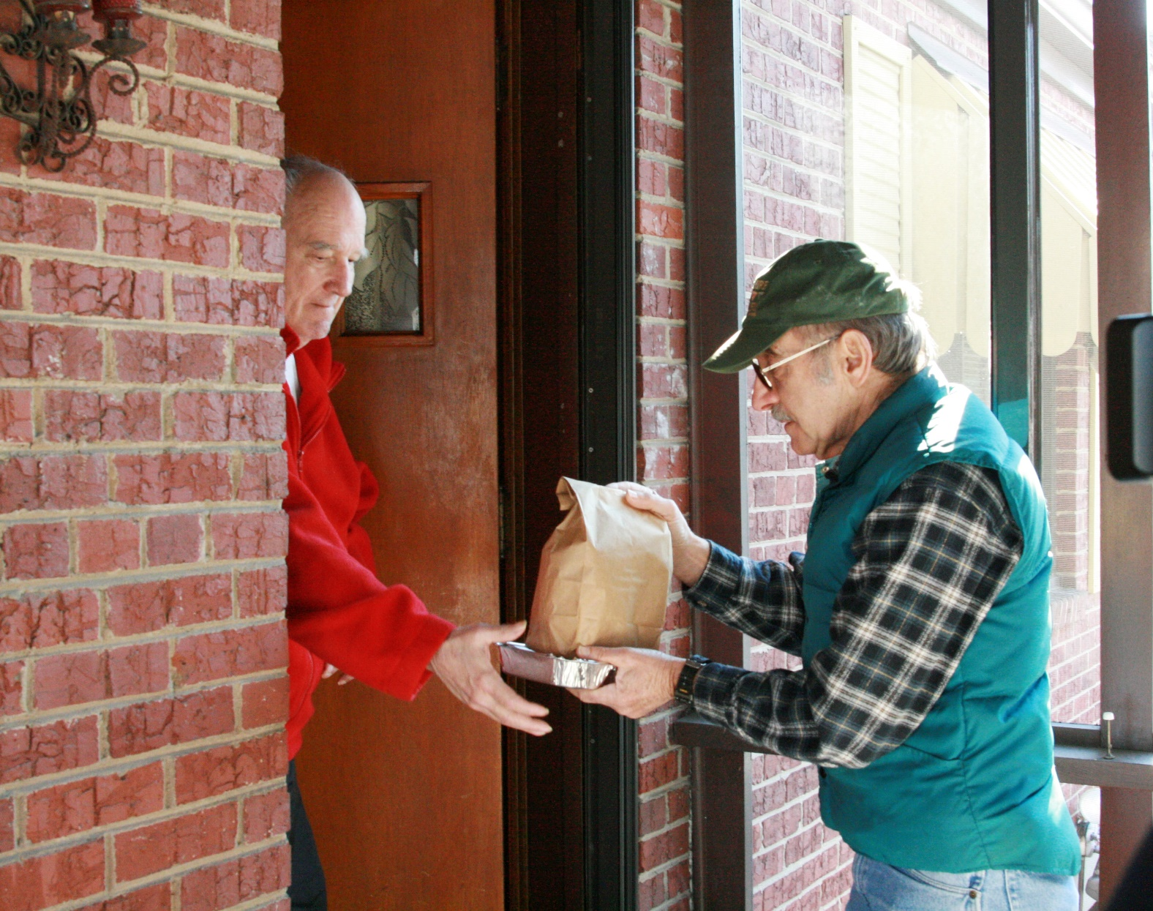
Something Magical Happens!
Notes:
Much evidence suggests benefits of home-delivered meals
Research needed
Quantify improvement in quality of life
Determine effectiveness of the daily “check in” and social contact

Slide 4

What is the Value?

Slide 5
Changing Environment
Funding cuts, increased costs
  Increase in waiting lists
  Need to make decisions based on positive health outcomes
Research needed
  Evidence-based
  Determine the value of the meal plus
Healthcare integration
  Opportunities with Healthcare Providers
Notes:
Federal, state and local funding cuts, increased transportation and food costs, and the lingering effects of the economic downturn have had devastating impacts on Meals on Wheels programs. Over the past several years, these compounding factors have resulted in hundreds of thousands of fewer seniors served, millions of fewer meals delivered, and a dramatic increase in waiting lists for the program.
Weekly delivery of frozen meals has since emerged as a solution to a list of challenges of daily hot meals including rising delivery costs, volunteer management, and food safety. In the frozen delivery model, drivers provide the full week’s meals in one delivery (or occasionally two) per week. Thereby limiting the frequency of the interaction between clients and volunteer or paid drivers

Slide 6
Partners
Partners with Meals on Wheels America
Researcher:
Kali S. Thomas, PhD, MA
and David Dosa, MD, MPH
  Center of Innovation for Long-Term Services and Supports
  Department of Veterans Affairs Medical Center, Providence, RI
  Center for Gerontology and Healthcare Research, School of Public Health, Brown University
Funder:
AARP Foundation

Slide 7
Design
Three-arm parallel, fixed, single-blinded randomized controlled trial (RCT)
620 target participants
1:1:1 randomization
Baseline survey (in person) and 15-week follow-up (via telephone)
Notes:
One thing that has made evaluation of the HDM program difficult, has been an adequate control group on which to base comparisons of outcomes. It is unethical to withhold meals from individuals who are need of assistance.
Taking advantage of the waiting lists as we had an aequate control group of individuals who self-identfy as needing home delivered meals but are unable to be served.
The randomized Controlled trial, or RCT, which is often considered the most powerful clinical research tool. In RCTs, researchers randomly assign participants to an intervention and then measure particular outcomes. Because of this assignment process, the distribution of factors that might affect the outcomes is likely to be similar across the groups. So, differences in outcome can be attributed to the intervention.

Slide 8
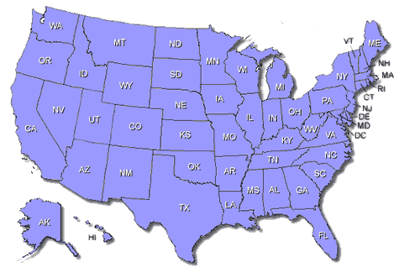
Eight Pilot Sites
Notes:
Aging, Disability & Transit Services of Rockingham County, Reidsville, NC
Athens Community Council on Aging, Athens, GA
Broward Meals on Wheels, Plantation, FL
Community Meals, Evelyn Rubenstein Jewish Community Center, Houston, TX
Interfaith Ministries for Greater Houston, Houston, TX
Meals on Wheels of Ocean County, Lakewood, NJ
Meals on Wheels of Rhode Island, Providence, RI
VNA Meals on Wheels, Dallas, TX

Slide 9
Study Design
In-person Interviews of all 626 study participants
Participants randomly assigned to daily-delivered meals (n=214), frozen, once-weekly delivered meals (n=202), or to remain on the waiting list (n=210)
Meal delivery began and continued 15 weeks
Baseline and outcomes analyses
Conducted follow-up interview over telephone
(n=459; 154 in control group, 174 in daily-delivery group, and 131 in frozen, once-weekly delivery group)

Slide 10
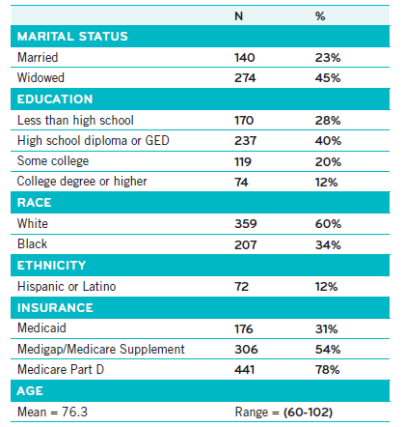
Demographics
Notes:
No significant differences between groups or across sites.
Majority were white female, widowed, had earned a high school degree with an average age of 76. In addition, less than 1/3 were received Medicaid, 54% were enrolled in a Medigap plan, and 78% had a Medicare Part D plan.

Slide 11

Initial Survey and Observations
Snapshot of Waiting List
Notes:
58% of participants report needing the help of another person with personal care needs because of a physical, mental, or emotional condition.
When asked about the future, only 63% of participants said that they have friends or relatives who would be willing and able to help them over a long period of time if they needed help with basic personal care activities.

Slide 12
Initial Survey
Help with Personal Care Needs
Notes:
58% of participants report needing the help of another person with personal care needs because of a physical, mental, or emotional condition.
When asked about the future, only 63% of participants said that they have friends or relatives who would be willing and able to help them over a long period of time if they needed help with basic personal care activities.

Slide 13
Initial Survey
Social Support
“How often do you have contact with friends or family?”
“Is there a family member, friend, or neighbor that you feel you can call on for help if you need it?”
Notes:
When asked about social support, only 59% of partinat reporting having contact with friends or family. An additional 24% reporting having contact with friends or family once or twice a week, 10% have contact once or twice a month, and 8% reporti having ocntact less than once a month.
13% have noone to call on for help
Suggests that a somewhat alarming proportion of older adults on waiting lists for MOW have limited if any social support.

Slide 14
Initial Survey
Nutrition Risk
Notes:
We also queried participants about factors that have shown to be related to nutritional risk by adapting questions from the Revised Nutrition Screening Initiative Checklist.²⁰ Individuals on waiting lists for home-delivered meals exhibited symptoms of nutritional risks: 47% reported eating alone for every meal, , 45% reported not having enough money to buy the food they needed, 51% of participants reported gaining or losing 10 pounds in the past 6 months without wanting to and 88% reported that they take three or more medications per day.

Slide 15
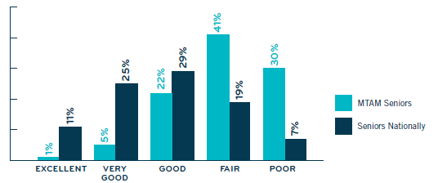
Initial Survey
Self Rated Health
Q: “Would you say that in general your health is...”
Groups significantly different at the p<0.001 level
Notes:
Have significantly worse self rated health
71% of MTAM sample rated their self rated health as fair to poor compared to 26% of seniors, nationally

Slide 16
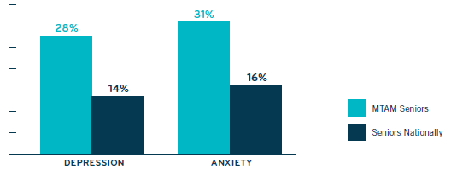
Initial Survey
Depression/Anxiety
Notes:
Twice as likely to screen positive for depression and anxiety.
Specifically,

Slide 17
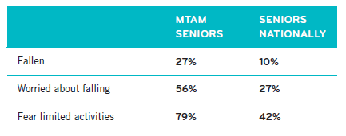
Initial Survey
Falls/Fear of Falling
Q: “In the last month, have you fallen down?”
Q: “In the last month, did you worry about falling down?”
Q: “In the last month, did this worry ever limit your activities?”
Groups significantly different at the p<0.001 level
Notes:
When examining falls, we found that individuals were more likely to have fallen in the past month
Fell on average 2.2 times ranging from 2-20 falls

Slide 18
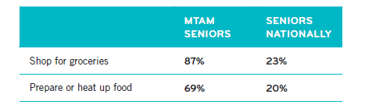
Initial Survey
Shopping/Preparing Food
MTAM: Q: “Are there times when you are not physically able to shop for groceries?”
Q: “Are there times when you are not physically able to prepare or heat up your food?”
NHATS: Respondents who replied (a) they had assistance for health or functioning reasons or (b) they performed the activity themselves with difficulty were considered to have need for assistance
Notes:
Also, of those who need help shopping with groceries, 12% do not have someone to help them
Of those who need help preparing or heating up food, 25% do not have someone to help.

Slide 19
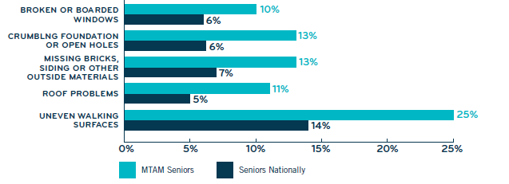
Surveyor Observations
Exterior of Dwelling
Q: “Standing in front of the respondent's home/building, did it have…”
Groups significantly different at the p<0.001 level
Notes:
Two times higher likelihood of having exterior hazards

Slide 20
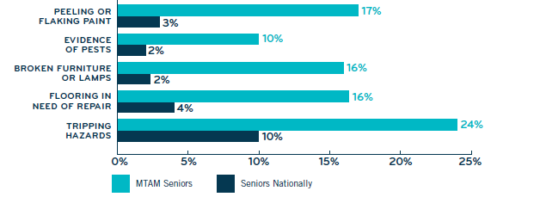
Surveyor Observations
Interior of Dwelling
Q: “Inside the respondent's home/apartment/unit, did you observe…”
Groups significantly different at the p<0.001 level
Notes:
Greatest differences inside the home… the most troubling given that these folks are homebound
3-5 times more likely to have interior hazards

Slide 21
Snapshot of Waiting List
Implications
Personal care
Social supports
Nutrition risk
Self reported health
Falls/Fear of falling
Depression/Anxiety
Shopping/Food preparation
Conditions of home

Slide 22
Results Final Assessment
Self Reported Improvement
Improvements in: | Control | Daily Delivered | Weekly Frozen
Self Rated Health | 23% | 29% | 24%
Self Rated Mental Health (Anxiety) | 7% | 12% | 10%

Slide 23
Results Final Assessment
Improvement in Isolation
Q: “How often do you feel isolated from others? Never, Rarely, Sometimes, Often?”
No statistically significant difference between groups

Slide 24
Results Final Assessment
Living Alone-Improvement in Isolation
Q: “How often do you feel isolated from others? Never, Rarely, Sometimes, Often?”
These differences were statistically significant (χ²= 8.92, p=0.01)
Notes:
When we examine improvement in ratings of how often individuals who live alone feel isolated, we see a statistically significant difference by group. Specifically, 36%

Slide 25
Results Final Assessment
Improvement in Loneliness
Loneliness measured using the UCLA 3-Item Loneliness Scale
No statistically significant difference between groups
Notes:
We used the three items that compreise the UCLA loneliess scale to create a lonenliess score for individuals at baseline and loniless.
Together, these three items assess the experience or percetion of a lack of close and.or emotionally satisfsying relationships.

Slide 26
Results Final Assessment
Living Alone -Improvement in Loneliness
Loneliness measured using the UCLA 3-Item Loneliness Scale
These differences were marginally statistically significant (p=0.09)
Notes:
When we stratified by the sample to examine improvement in loneliness among individuals that live alone, we found grater rates of improvement among the groups receiving meals. Specifically 46% of participants receiving daily-delivered meals and 45% receiving weekly frozen meals reported less loneliness at follow-up compared to 28% of the control group.
While only marginally significant, this suggest that HDM may improve loneliness of individuals living alone.

Slide 27
Results Final Assessment
Improvement in Worry About Staying Home
Q: “How often do you worry about being able to remain in your home? Never, Rarely, Sometimes, Often?”
These differences were statistically significant (χ²= 9.46, p=0.009)
Notes:
Almost 1/3 that received daily delivered meals worried less at follow-up.

Slide 28
Results Final Assessment
Living Alone - Improvement in worry about staying home
Q: “How often do you worry about being able to remain in your home? Never, Rarely, Sometimes, Often?”
These differences were statistically significant (χ²= 9.04, p=0.01)
Notes:
We found that differences were even more pronounced
Among those that live along, 42% receiving daily-delivered meals reported less worry at follow-up compared to 26$% of participants receiving weekly, frozen meals and 18% of the control group.

Slide 29
Results Final Assessment
Lower Rate of Hospitalizations
Hospitalized during study period
  14% of individuals who received meals
  20% of individuals in the control group
  Marginally significant difference (χ²=2.99, p=0.08)
Notes:
Using our sample of individuals with data at both time points, we found that 14% of individuals who received meals were hospitalized during the study period compared to 20% of individuals in the control group.
There were no statistical decreases by meal delivery method.

Slide 30
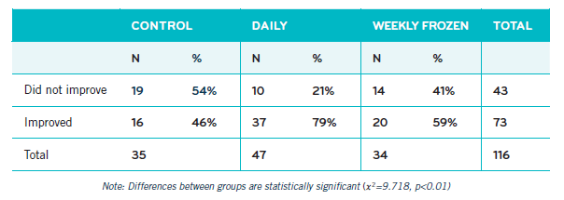
Results Final Assessment
Falls Among Population of Fallers
Among participants who had fallen in the past month at baseline (n=116)
Notes:
Among participants who had fallen in the last month as reported on their baseline interview,

Slide 31
Results Final Assessment

Slide 32
Results Final Assessment
Reasons for Feeling Safer
 | Daily | Frozen, Once Weekly
Delivery | 49% | 24%
Meal | 25% | 31%
Out of Kitchen | 15% | 33%
Stay Home | 11% | 29%
Other | 6% | 6%
Q: “In what ways does it make you feel safe?”
These differences were statistically significant (χ²= 11.07, p=0.03)
Notes:
When probed about why the meals help them to feel safe, the qualitative results suggest the reasons differed between the two groups. Among the group receiving daily delivered meals, almost half (49%) reported some aspect of the delivery (i.e. social contact or being checked in on) contributing to feelings of safety, compared to 24% of respondents receiving frozen meals.
In response to the follow-up probe, “in what ways does it make you feel safe?” example responses from individuals receiving daily-delivered meals that referenced the delivery of the meal were:
“Someone will see me daily”
“Because someone is coming over”
“Someone to watch over me”
“Someone checking in daily”
“Someone checking in on me - if I fall, they can call an ambulance.”
Meal
Dependable
Healthy
Not Injured
Out of Kitchen
No Leave Home
Other- people see people coming in and out, not having other people come in and cook for me

Slide 33
Results Final Assessment
Less Lonely and More Social Contact
Q: “Do services received from the home-delivered meals program help you feel less lonely?”
χ²= 4.61, p<0.05
Q: “If you did not receive home-delivered meals, would you say “I would have little daily contact with people?””
χ²=5.21, p<0.05
Notes:
When participants were asked “Do services received form the HDM program help you feel less lonely,

Slide 34
Satisfaction with Program
99% of participants in both groups would recommend program to others
Reasons for recommendation vary
 | Daily | Frozen, Once Weekly
Help | 41% | 27%
Driver | 18% | 7%
Meal | 51% | 73%
Q: “Why would you recommend this program to others? ?”
These differences were statistically significant (χ²= 11.9, p=0.003)
Notes:
Help- convenience, caregivers, peace of mind
Driver- friendly visit, purpose in day, check in
Meal, Cost, dependable, healthy, tasty

Slide 35
Key Findings
Those receiving and/or requesting MOW:
Poorer self-rated health
Positive for depression and mental health challenges
Recent fall and fear of falling
Require assistance with shopping or preparing food.
Health and/or safety hazards inside and outside home.

Slide 36
Key Findings
Those receiving home-delivered meals:
  Improvements
    Anxiety
    Self-rated health
    Isolation
    Loneliness
Reduced rates of:
  Hospitalizations
  Falls

Slide 37
Key Findings
Those receiving daily meal delivery:
Improvement in mental health (anxiety)
Improvement in self-rated health
Reductions in the rate of falls
Improvement in feelings of isolation and loneliness
Decreases in worry about being able to remain in home

Slide 38
Key Findings
Those receiving daily delivered compared to weekly:
Feel safer
Helped them to eat healthier food
More social contacts
Less loneliness

Slide 39
Key Findings
Those receiving daily delivered and lived alone:
Decrease worry about being able to remain in the home
Improvements in feelings of isolation and loneliness

Slide 40
Conclusions
Seniors on Meals on Wheels waiting lists need a variety of supports
Need additional help beyond meals
  Important to assess these needs
  Referral to other services
  Opportunities for collaboration
Notes:
Assess needs: they can answer these questions!
Referral to other services: without asking we’ll never know.
Opportunities: grant writing, collaboration, innovative program partnerships, get these seniors SOME help

Slide 41
Conclusions
Programmatic decisions made on research
Further research
  Evidence-based
  Determine the healthcare savings
Healthcare integration
  Opportunities to market the value of Meals on Wheels and the impact on healthcare costs
Notes:
Assess needs: they can answer these questions!
Referral to other services: without asking we’ll never know.
Opportunities: grant writing, collaboration, innovative program partnerships, get these seniors SOME help

Slide 42
Study Limitations
Sample size (power)
Rate of attrition
Once-weekly delivery in this study by Meals on Wheels programs were not comparable to the competitor model that drop-ships frozen meals
Findings are based on self-report

Slide 43
Next Steps
Examine healthcare utilization and outcomes using Medicare Claims
Determine effects recognized by caregivers of Meals on Wheels clients
Conduct larger scale study

Slide 44

Thank You!
A special thanks to VNA Meals on Wheels for their participation in this project.

